Slide 1
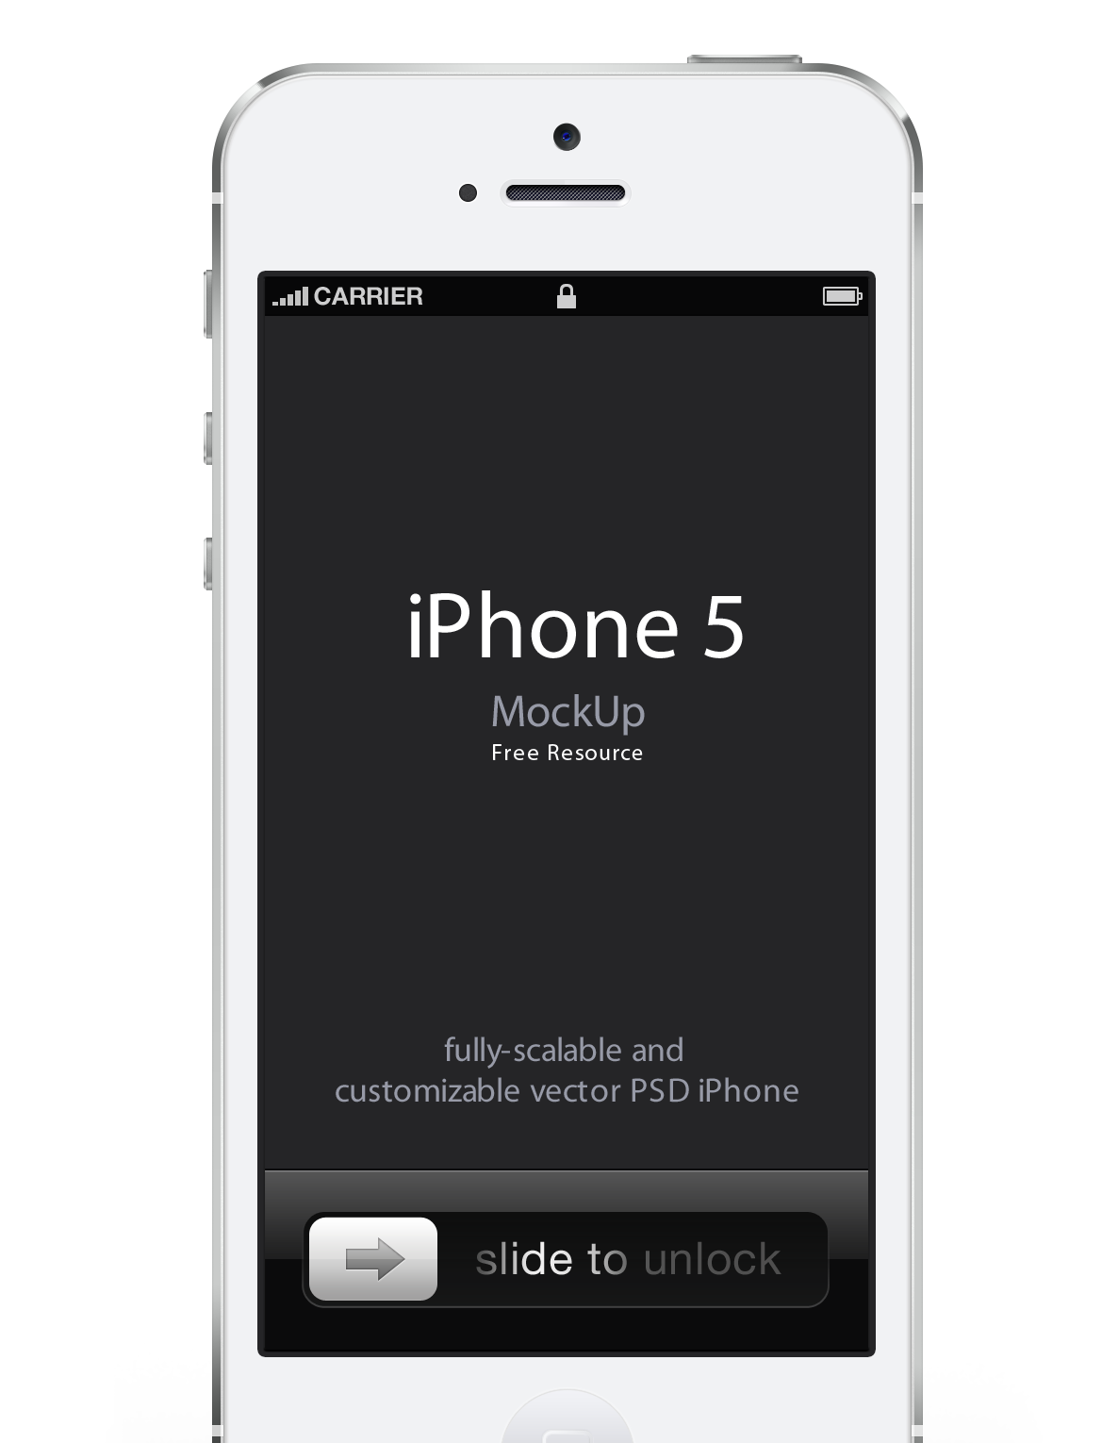



Data Science Class (DAT4) – Final Project

Slide 2
What do we do:
Feedback & Response Platform:
Brands
Broadcasters
Publishers
k-12, higher-ed
Government
non-Profits

Slide 3
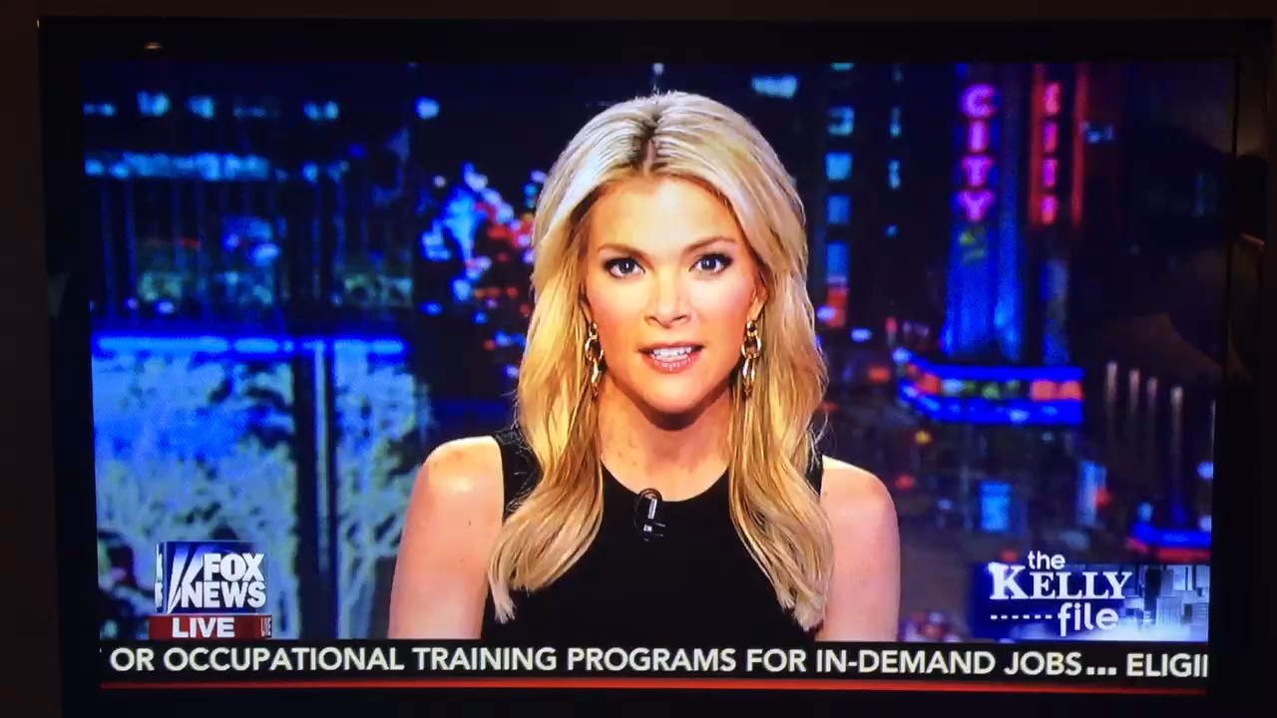
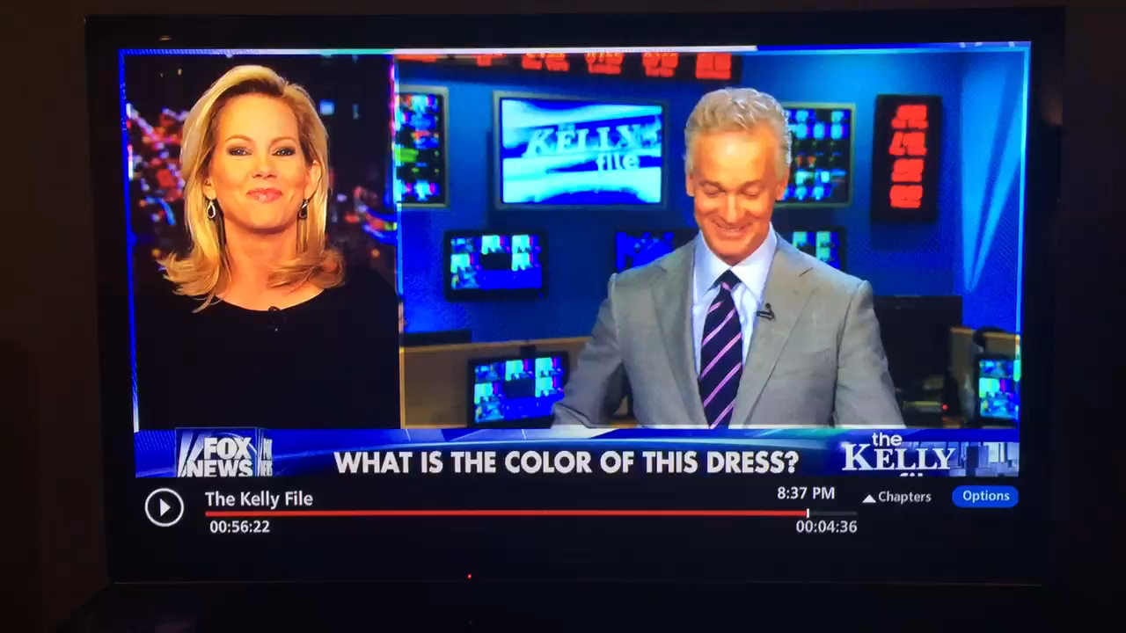
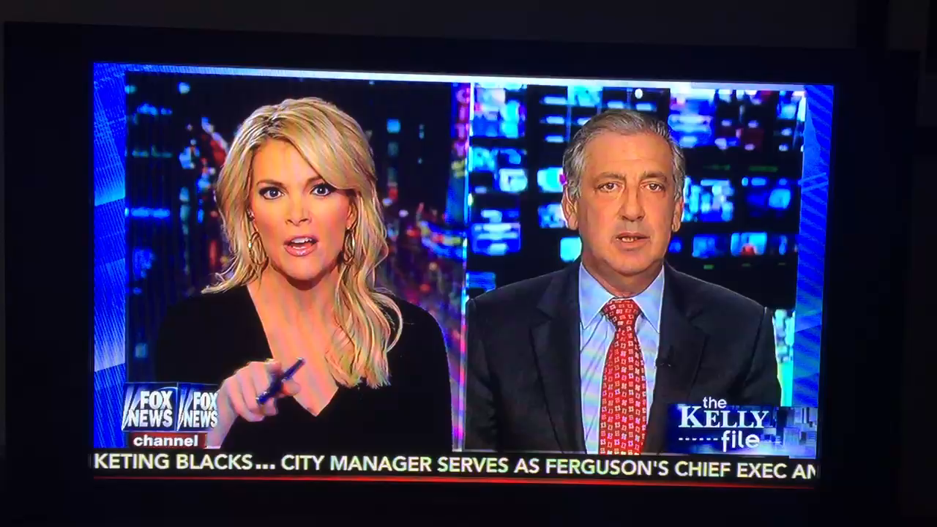

Slide 4
We collect a lot of data…

Slide 5
The Problem:
We don’t present the content in an organized (or particularly useful) way…

Slide 6
The Hypothesis:
It is highly likely that over time, with the creation of many questions (polls and brainstorms), NATURAL categories have emerged.

Slide 7
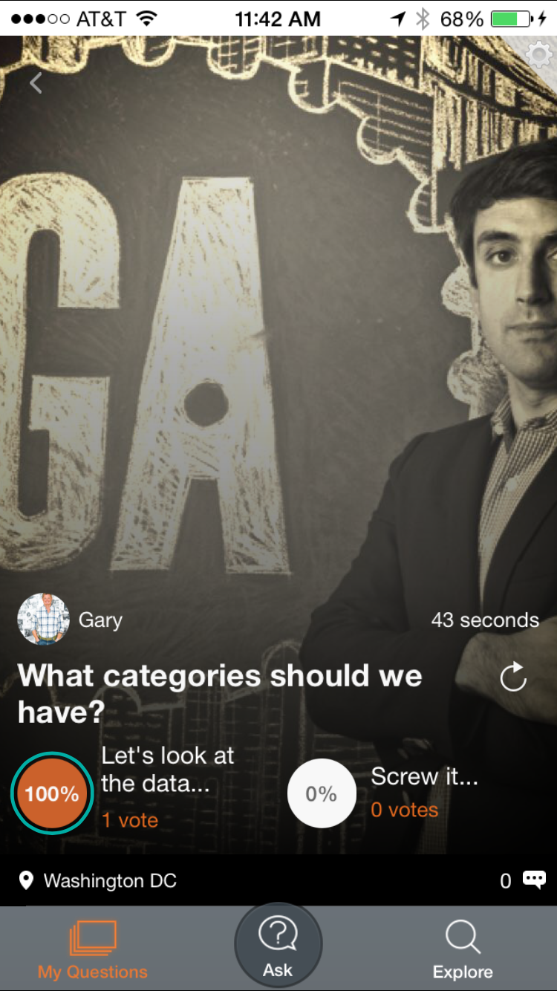
The Question/Challenge/Need:
What are the natural content 'Categories' that have been created via app usage?

Slide 8
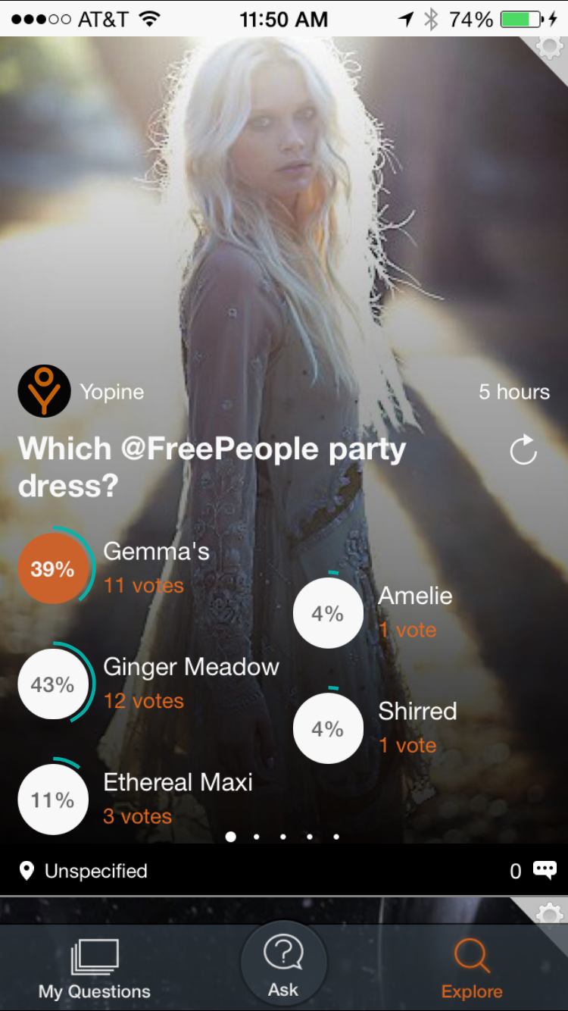
Why:
All content is presented in ‘Explore’ view today simply chronologically.

Slide 9
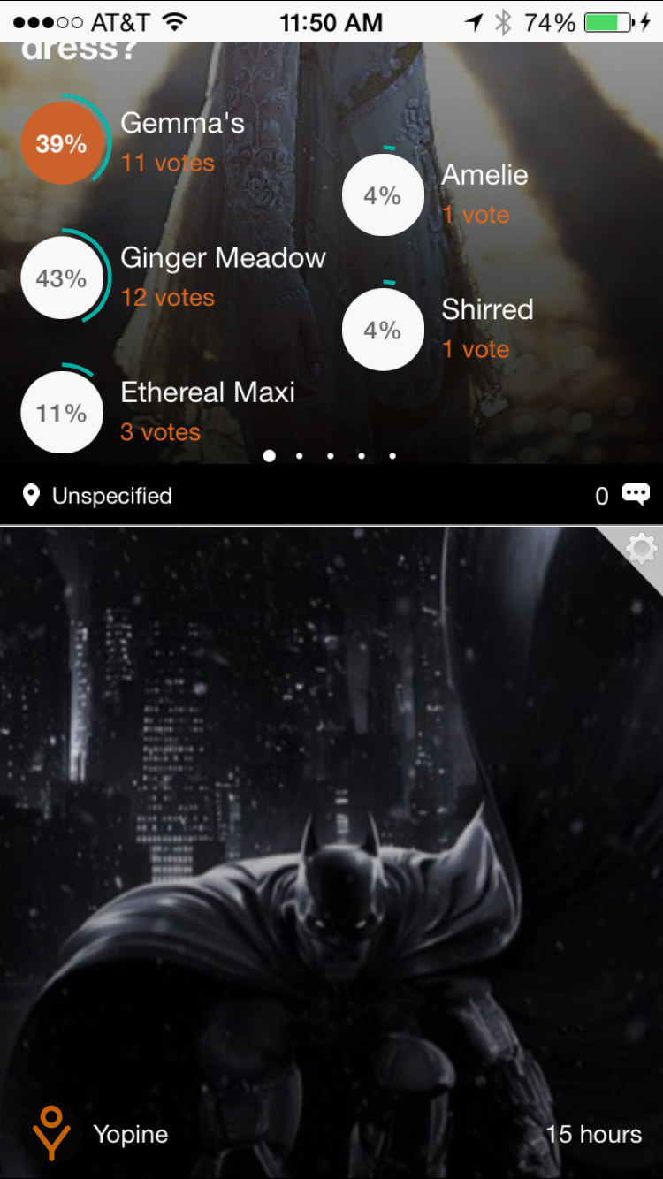
Why:
All content is presented in ‘Explore’ view today simply chronologically.

Slide 10
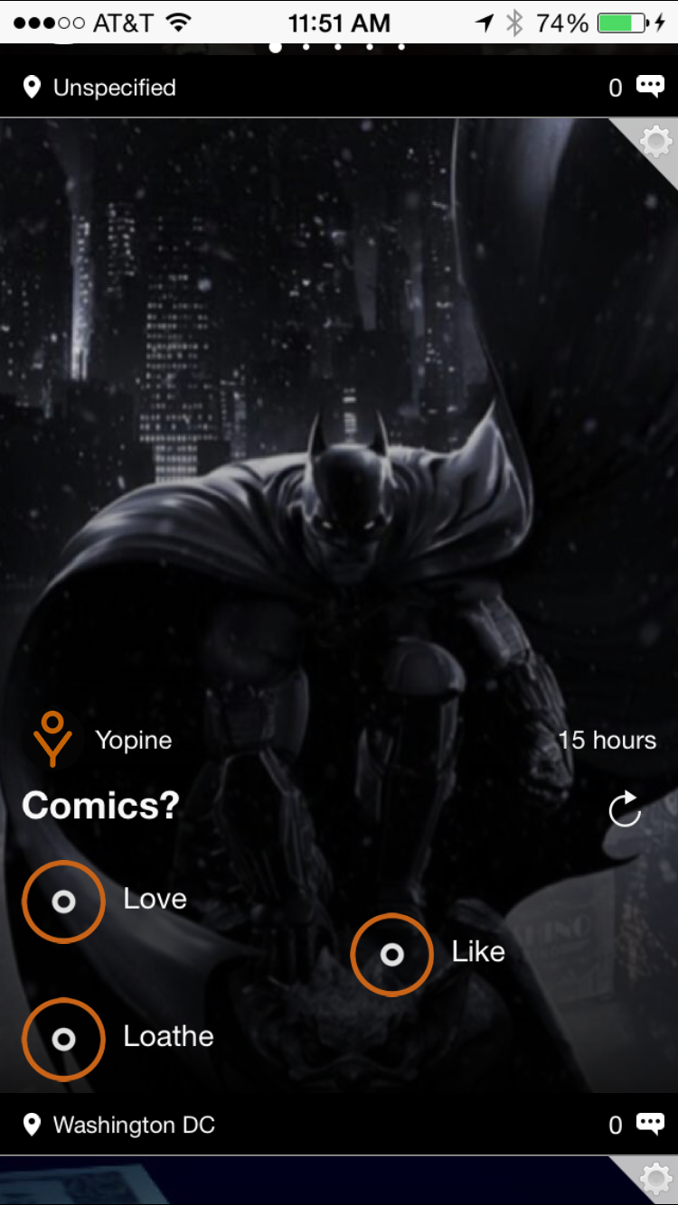
Why:
All content is presented in ‘Explore’ view today simply chronologically.
There is nothing that keeps a fashion oriented poll separated from a comic book poll…

Slide 11
Why:
You can bet those are two very different people/demographics...
Users shouldn’t have to sift through content that is of no interest to them.

Slide 12
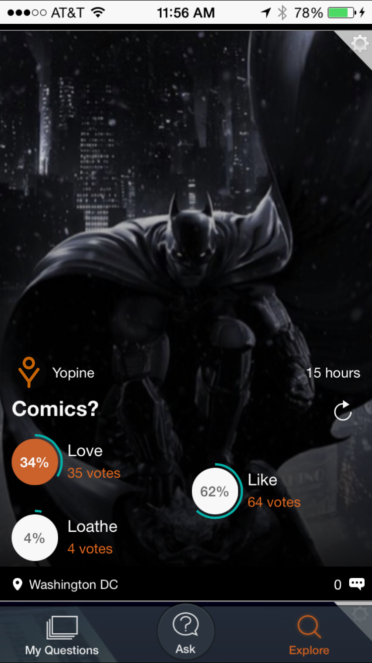
Data:
Everything we need to know is contained in the questions and the responses.

Slide 13
Data:
Everything we need to know is contained in the questions and the responses.
We will let Machine Learning do the work to dictate how our content should be organized.

Slide 14
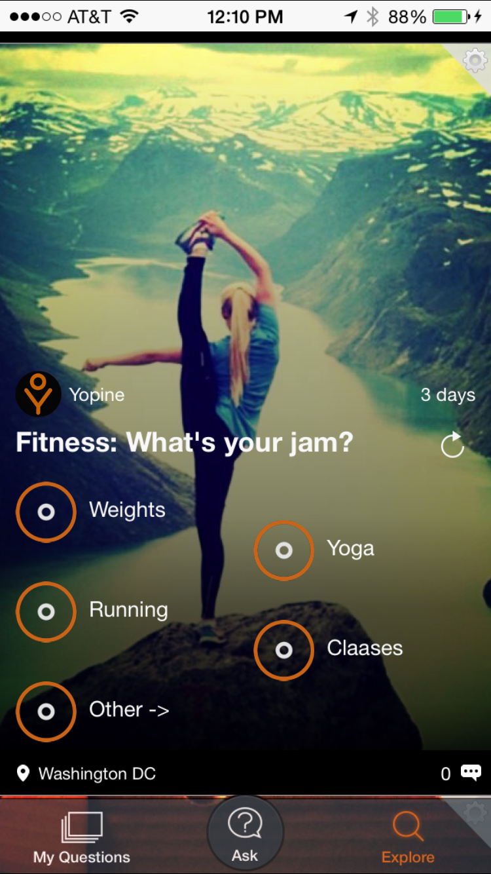
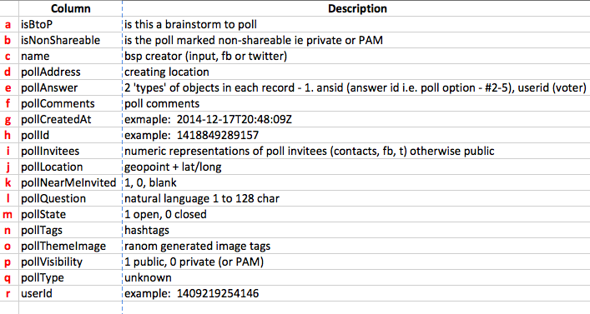
the Data:
first, the metadata -

Slide 15
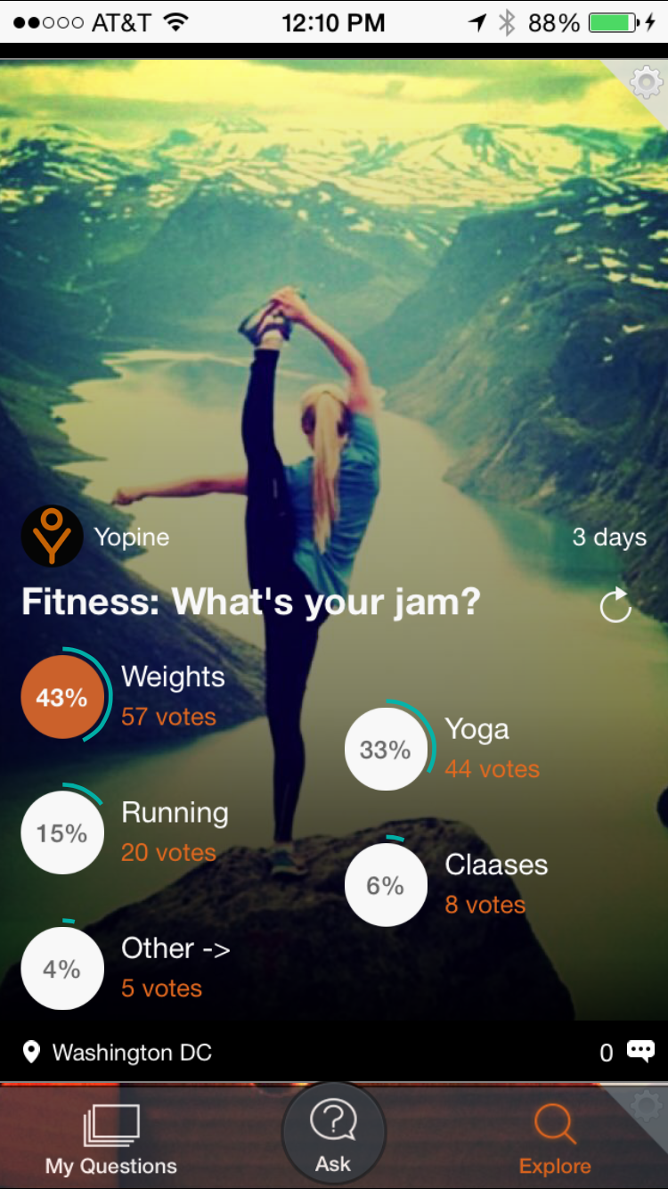
the Data:
first, the metadata -
2 columns matter – pollQuestion (#12) & pollAnswer (#5)

Slide 16
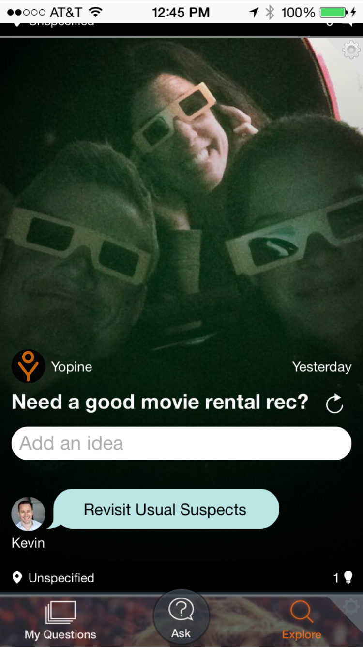
the Data:
first, the metadata -
2 columns matter – pollQuestion (#12) & pollAnswer (#5)

Slide 17
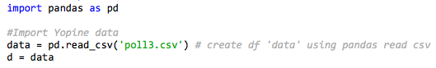
the Data:

Slide 18
the Data:
Data frame screen shot goes here

Slide 19
The Plan (the data science):
K-means + TFIDFvectorizer
LDA
Why:
Need to group similar data into sets(clustering)
Need to discover topics from human sentences(NLP)

Slide 20
Why:
K-means + TFIDFvectorizer – the code is making topics. Now I willextract sentences from the polls/brtainstorms and make a sentences list out of it.

Slide 21
Why:
K-means + TFIDFvectorizer – the code is making topics. Now I willextract sentences from the polls/brtainstorms and make a sentences list out of it.
LDA -

Slide 22
My hope is that the data will reflect what I believe (through 2.5 years of cursory observation) to be the correct categories.

Slide 23
My hope is that the data will reflect what I believe (through 2.5 years of cursory observation) to be the correct categories.
Whatever the data reveals will be what goes into the product.

Slide 24
Results: animals, anyone, books, brands, business, celebrity, class, coffee, contest, dancing, donate, drinks, fashion, favorites, food, games, gear, health, hobbies, holidays, home, joke, meetup, mood, movies, music, news, outdoors, places, plans, religion, rides, school, shopping, smoke, social, sports, startups, tech, test, travel, tv, weather;

Slide 25
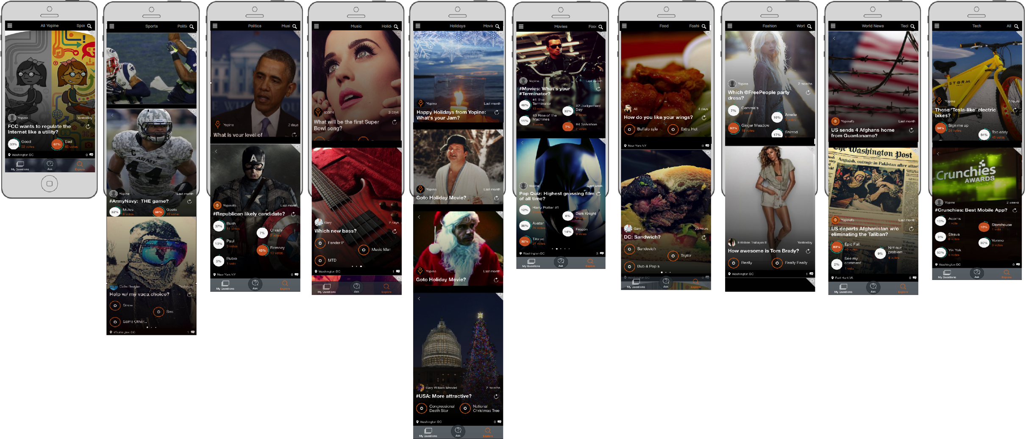
Best Guess @ Categories:
Sports
Politics
Music
Holidays
Movies
Food
Fashion
World
Tech
Something like this…

Slide 26
Actual Roadmap Categories:
Xxx
Xxx
Xxx
Xxx
Xxx
xxx

Slide 27
Challenges:
Data – easy (1 table, 2 columns)
Cleaning it – pretty easy…clean
Deciding on models – tho I sorta knew from the first class after seeing the NPR One project
Code – I thought this class was being done in COBOL.

Slide 28
Successes:
Seeing my baby all growed up and from a purely scientific perspective revealing product direction and roadmap (nobody can really blame me for some whacky category like ‘weather’.
Having the tools in place to finish this model so that I can run it every so often and adjust the categories based on what the people are saying.

Slide 29
Next steps: perhaps add weight to each instance of each categorized row with its associated ‘voteCount’
A few more projects using this data set:
When I get a new document (aka poll) how accurately can I automatically place it into an existing category?
What is the overall tone/sentiment of votes contributions and comments? Is the Yopine user base mostly happy and positive or angry a-holes?
Utilize our #tag data to help categorize

Slide 30
Thank you!
gary@yopine.com
@garywmendel
@YoYopine

